Slide 1
Optical Character Recognition
Jorge Melo & Xavier Pinho

Slide 2
Introduction

Slide 3
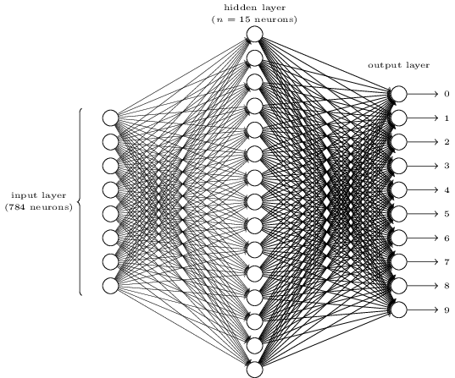
Introduction
Input layer
256 neurons

Slide 4
Methods
Dataset
Features Target
Architecture
AM Hardlim
Purelin
WAM Logsig
Learning rate = 0.5 Training Function = trainsgd Epochs = 1000 (scaled conjugate gradient) Performance = 1e-6
256
10
500
Notes:
The Dataset was draw by the 2 elements of the group.
It has 500 rows by 256 columns.
Each row represents a digit.
The target has the same number of lines but only 10 columns, that represents the digit to which the row corresponds.
We divided the dataset in train and test in the proportion of 85 to 15 aiming to reduce a possible overfitting.
The tested 2 approaches:
With associative memory and without it.
The associative memory receive an input and then works as a corrector/filter to make the digit ‘more perfect’, using the PerfectArial.mat file.
As to the transfer functions, we tested 3 different ones:
Hard-limit transfer function
Linear transfer function
Log-Sigmoid transfer function.
Our classifiers we’re tested with:
Learning rate = 0.5
1000 epochs
And a performance = 1e-6

Slide 5
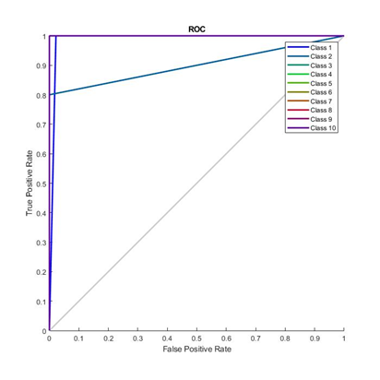
Results
Table 1 – Results of accuracy for the different models. Figure 1 - ROC curve for logsig WAM.
 | Purelin | Hardlim | Logsig
AM + Classifier | 10% | 8% | 12%
Classifier | 94% | 92% | 98%
Notes:
We evaluate the models with accuracy values and the ROC curves.
The best classifier is the Logsig WAM.
WAM > AM

Slide 6
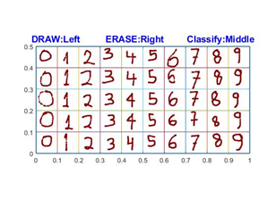
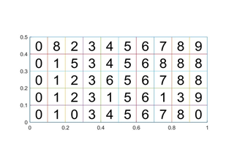
Conclusion
Figure 2 – Representation of the input and the predicted numbers using logsig WAM.
Notes:
Here are the results using the mpaper.m:
Our best model, logsig without associative memory predicted 11 digits wrong in 50.
We conclude that classifiers without associative memory are the ones with better results.
We conclude that our dataset has low variability (small amount of data).
To improve our results we could add more data or maybe try to use convolutional neural networks.
We will now show a demonstration of our work.

